Slide 1

Name: M. Vani Batchno: 435
Innomaticsresearchlabs
Customer Churn Analysis
Presented By:
Aravind Racharla
Shiva Shankar

Slide 2

Agenda
Project Overview
Problem Statement
Data Source
Data Preparation
Dashboard Visualizations
Applications & Recommendations
Conclusion
Any Queries

Slide 3
Business Problem
The telecom company is facing increasing customer churn in recent quarters periods, causing revenue loss and reduced customer lifetime value. Although large volumes of customer data are available, the company lacks clear insights into the key factors driving churn and the most vulnerable customer segments.
Without actionable analytics, retention strategies remain ineffective. This project aims to identify churn drivers and high-risk customers using Power BI to support data-driven business decisions.

Slide 4
Project Objective
To analyze customer churn data and identify the key factors driving customer churn
To identify high-risk customer segments likely to churn
To evaluate the impact of demographics, service usage, contract types, and billing methods on churn
To deliver actionable, data-driven insights through Power BI dashboards
To support effective customer retention strategies and reduce revenue loss

Slide 5
Project Overview
This project focuses on Customer Churn Analysis using customer demographics, service usage, billing, and contract-related data.
The objective is to identify churn patterns, understand key drivers of churn, and analyze customer behavior across different segments.
Interactive Power BI dashboards were created to visualize churn rate, tenure patterns, service subscriptions, and billing insights.
The analysis helps businesses identify high-risk customers and design effective retention strategies.

Slide 6
Data Preparation
Imported the dataset into Power BI and performed data cleaning.
Handled missing values and corrected data types for numeric and categorical columns.
Created Tenure Groups (<1 Year, 1–2 Years, 2–3 Years, etc.) for better analysis.
Calculated key measures such as:
Total Customers
Churned Customers
Churn Rate
Average Monthly Charges
Average Tenure
Applied data validation using cards and tables before building dashboards.

Slide 7
Dashboard Overview
The Power BI report consists of four main dashboards:
Customer Demographics Analysis
Service Subscription Analysis
Contract & Billing Insights
Churn Prediction & Key Drivers
Each dashboard includes interactive slicers for contract type, gender, senior citizen status, and internet service.

Slide 8
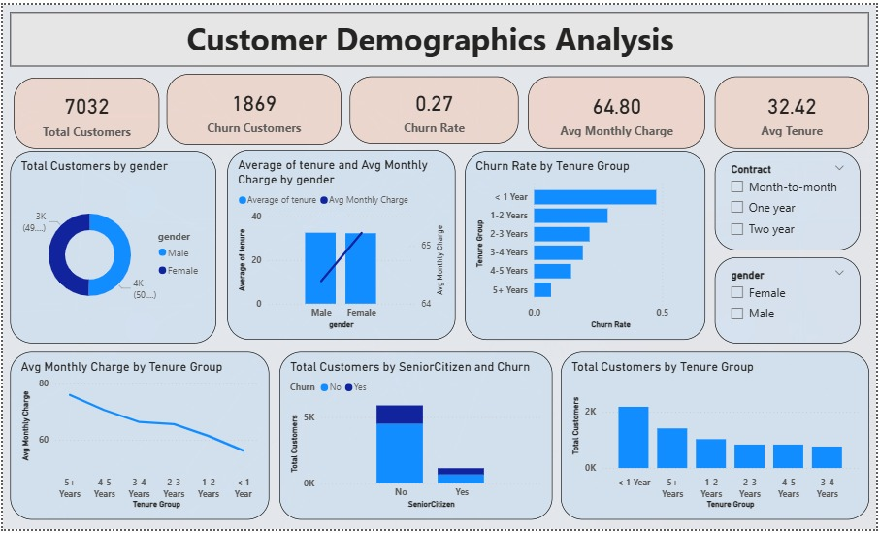

Slide 9
Customer Demographics Analysis
KPI Cards:
Total Customers → 7032
Churn Customers → 1869
Churn Rate → 27%
Avg Monthly Charge → 64.80
Avg Tenure → 32.42
Charts & Visuals:
Donut Chart → Total Customers by Gender
Clustered Column Chart → Avg Tenure & Avg Monthly Charge by Gender
Bar Chart → Churn Rate by Tenure Group
Line Chart → Avg Monthly Charge by Tenure Group
Stacked Column Chart → Total Customers by SeniorCitizen and Churn
Column Chart → Total Customers by Tenure Group
Slicers:
Contract
Gender

Slide 10
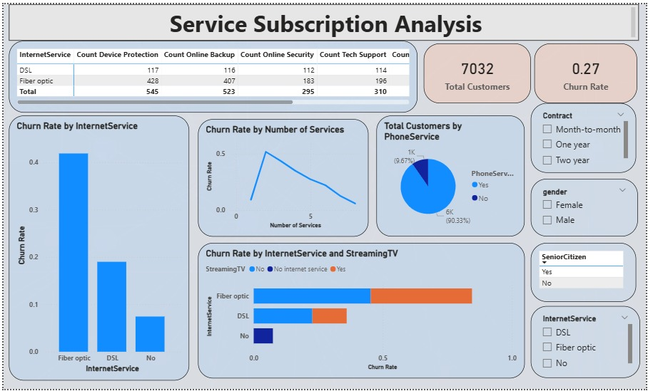

Slide 11
Service Subscription Analysis
KPI Cards:
Total Customers
Churn Rate
Charts & Visuals:
Table Visual → Internet Service vs Add-on Services
(Online Security, Backup, Device Protection, Tech Support)
Bar Chart → Churn Rate by Internet Service
Line Chart → Churn Rate by Number of Services
Donut Chart → Total Customers by Phone Service
Stacked Bar Chart → Churn Rate by Internet Service & Streaming TV
Slicers:
Contract
Gender
Senior Citizen
Internet Service

Slide 12
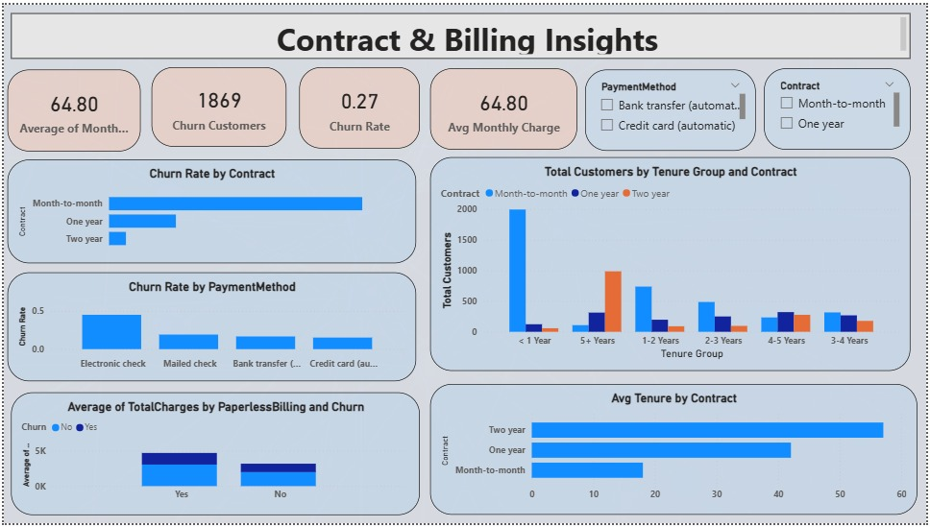

Slide 13
Contract & Billing Insights
KPI Cards:
Avg Monthly Charge
Churn Customers
Churn Rate
Avg Monthly Charge (billing focus)
Charts & Visuals:
Bar Chart → Churn Rate by Contract
Clustered Column Chart → Total Customers by Tenure Group & Contract
Bar Chart → Churn Rate by Payment Method
Stacked Column Chart → Avg Total Charges by Paperless Billing & Churn
Bar Chart → Avg Tenure by Contract
Slicers:
Payment Method
Contract

Slide 14
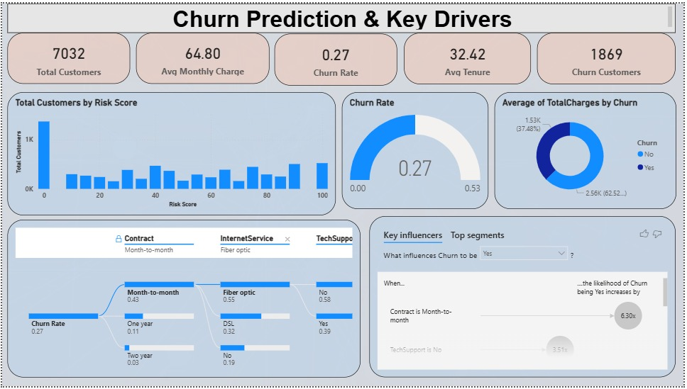

Slide 15
Churn Prediction & Key Drivers
KPI Cards:
Total Customers
Avg Monthly Charge
Churn Rate
Avg Tenure
Churn Customers
Charts & Visuals:
Column Chart → Total Customers by Risk Score
Gauge Chart → Churn Rate
Donut Chart → Avg Total Charges by Churn
Decomposition Tree → Churn by
  Contract
  Internet Service
  Tech Support
Key Influencers Visual → What influences Churn = Yes

Slide 16
Applications & Recommendations
Customer Retention Focus
Identify high-risk churn customers and offer personalized discounts and retention plans.
Promote Long-Term Contracts
Encourage month-to-month customers to move to one-year or two-year contracts with incentives.
Improve Service Bundling
Promote add-on services like Tech Support and Online Security to reduce churn.
Optimize Billing Methods
Encourage automatic payment methods to improve customer convenience and reduce churn.
Data-Driven Monitoring
Use Power BI dashboards for continuous churn tracking and proactive decision-making.

Slide 17
Challenges Faced During the Project
Data Quality Issues
The dataset contained missing and inconsistent values (especially in Total Charges and service fields), which required careful cleaning and transformation.
Understanding Business Logic
Interpreting churn from a business perspective (tenure, contracts, services) was challenging and required domain understanding, not just technical analysis.
Selecting the Right Visuals
Choosing visuals that clearly communicated insights without cluttering the dashboard required multiple iterations and validation.
Identifying True Churn Drivers
Churn depended on multiple factors, making it difficult to isolate key drivers without using advanced visuals like Key Influencers and Decomposition Tree.

Slide 18
Conclusion
Churn rate is 27%, mainly driven by month-to-month contracts nearly 41% in entire month to month contracts
Fiber optic users show higher churn
Longer tenure & bundled services reduce churn
Dashboards help businesses take data-driven retention decisions
Customers with longer tenure and bundled services show higher retention.
These insights help businesses improve customer satisfaction, reduce churn, and increase profitability.

Slide 19


Slide 20

THANK YOU

